Slide 1
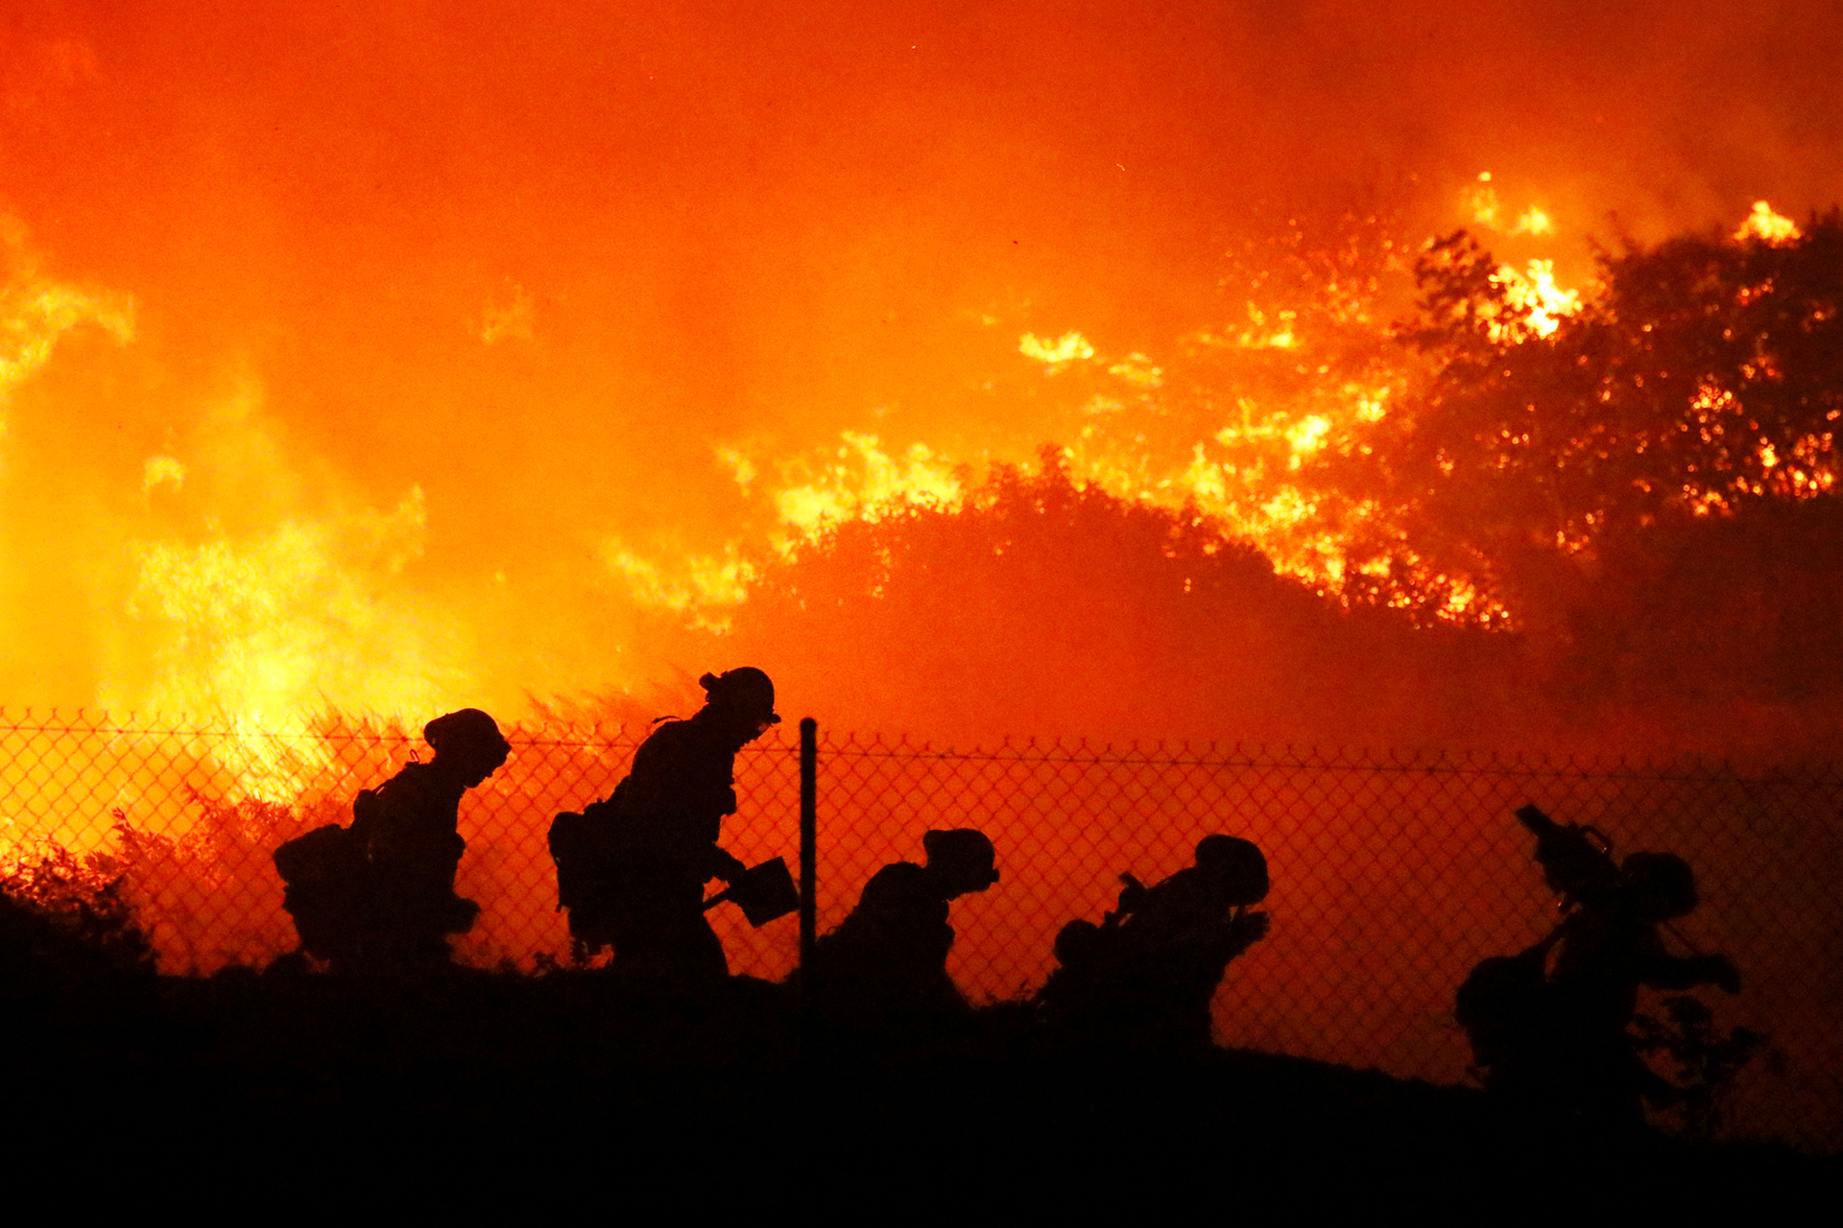
California wildfires
identifying Misinformation in Disaster-Related Social Media Posts
Beth Hamilton
Viviana V. Roseth
Maninder Virk
February 21, 2020

Slide 2
Outline
Problem statement
Scope
Steps
Desk research
Data collection
Data analysis
NLP classification
NLP clustering
Consolidation of strategies
Conclusions

Slide 3
Problem statement
While social media increasingly becomes the first source of information about disasters, this information is not always correct. Posts can be misleading or mistaken. On rarer occasion, users intentionally spread misinformation.
How can emergency management agencies identify incorrect information regarding disasters?

Slide 4
identifying Misinformation in Disaster-Related Social Media Posts
California wildfires
In the U.S.
Broad news coverage
Relatively recent
Twitter
Popular social media platform
Information on twitter gets propagated fast
Short and concise

Slide 5




4 steps to address problem
Desk research
Data collection
Data analysis: two strategies
Consolidation

Slide 6
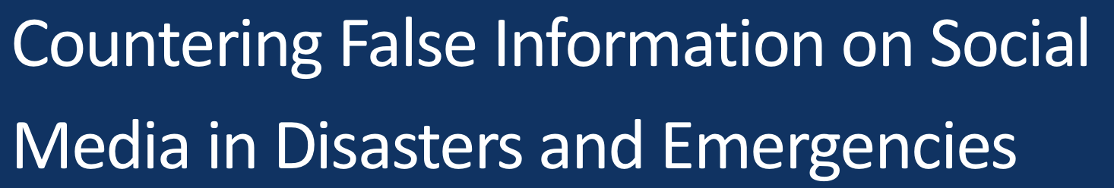
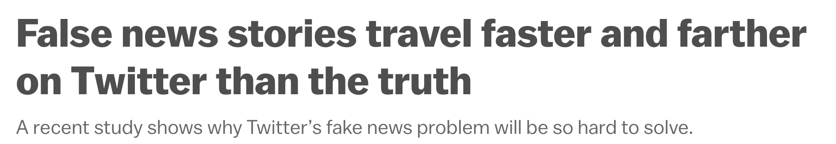
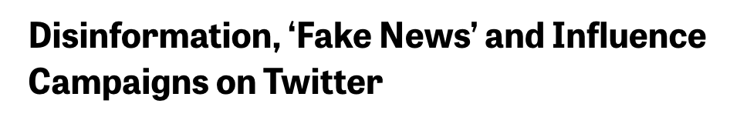
Desk research
Disaster-related misinformation can take different forms: incorrect, insufficient, opportunistic, outdated.
Department of Homeland Security, 2018
Misinformation is more likely to be retweeted and favorited by bots, but also humans
MIT, 2018
- Human and bot tweeting patterns differ
- The most important misinformation sources can be grouped under four categories: Trump Support, Hard Conservative, Conservative, Other right-leaning.
The Knight Foundation, 2018

Slide 7


Data collection
Parameters:
1) ID number
4) Text
7) Favorites
2) Username
5) Date
8) Mentions
3) To
6) Retweets
9) Hashtags
From Twitter…
…To a data frame
Python module:
GetOldTweets3
28479
Tweets

Slide 8
Data analysis : two strategies
Using usernames (classification):
Using tweets (clustering):
OR

Slide 9

Strategy 1: NLP Classification
Question: How to spot likely sources of misinformation?
Check account
Public profile/tweets using
Twitter API
Botometer
Score
Receive a probability of account being a bot -- 0 = human | 1 = bot
Bayes' theorem to help estimate the overall prevalence of bots
balance false positives with false negatives

Slide 10
Strategy 1: nlp Classification
X
Y
Words:
Username, hashtags, tweet
Model Name | Train Score | Test Score
Multinomial Naïve Bayes | 0.900 | 0.890
Decision Tree | 0.744 | 0.735
Bagging Classifier | 0.997 | 0.978
Random Forest | 0.999 | 0.991
Extra Trees | 0.999 | 0.996
AdaBoost Classifier | 0.700 | 0.932
Likely bot: True (score > 0.5), False (score < 0.5)
This model can predict whether a username is a bot or not with 99% accuracy.

Slide 11
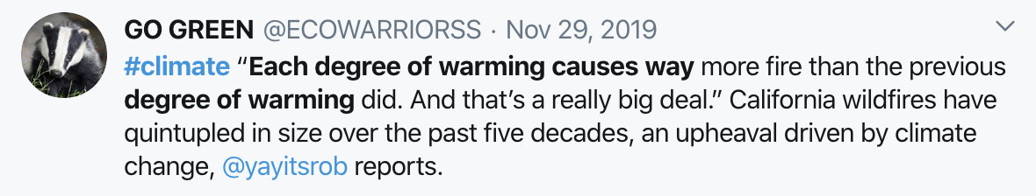
Strategy 2: CLUSTERING TWEETS
Pre-process: TFIDF Vectorizer, customized stop-words
Models: K-Means Clustering and DBSCAN
Pre-process: TFIDF Vectorizer, expanded customized stop-words, n-grams 1,1 and 1,2
Models: K-Means Clustering and DBSCAN

Slide 12
Strategy 2: CLUSTERING TWEETS
Hashtag clusters
Cluster 1: | kincadefire gettyfire news tickfire californiapoweroutage
Cluster 1I: | foxnews tuckercarlson pray californiablackouts newsom
Cluster III: | climatechange climatecrisis climateemergency globalwarming climatechangeisreal
Addressee clusters
Cluster I: | youtube abc gavinnewsom nbcnews googlenews
Cluster 1I: | realdonaldtrump gavinnewsom potus abc gop
Text clusters
Cluster I: | trump threatens threatens cut federal aid threatens pull pull federal
Cluster 1I: | daniel turner climate change hey aoc government dereliction not climate

Slide 13
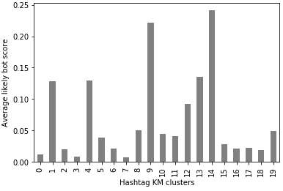
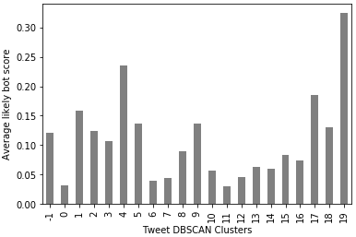
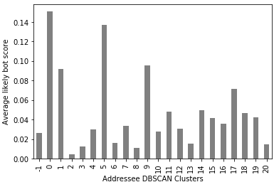
consolidation
Hashtags
Tweets
Addressees

Slide 14
Conclusions
Machine learning is a tool complement, not supplement human analysis.
Although some machine learning methods can be useful at identifying misinformation and bots in tweets, this is a problem that needs some human analysis as well. Bot detection is hard and there are some kinds of bot-like behaviors that are spotted more easily by humans.

Slide 15
Conclusions
Not all bots are bad, and some humans are worse.

Slide 16
Questi0ns?

